Slide 1

Hyperspectral Image Classification
Raymond H. Chan
Department of Mathematics Chinese University of Hong Kong
Supported by HKRGC
1

Slide 2



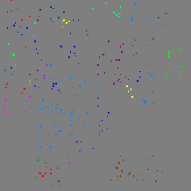
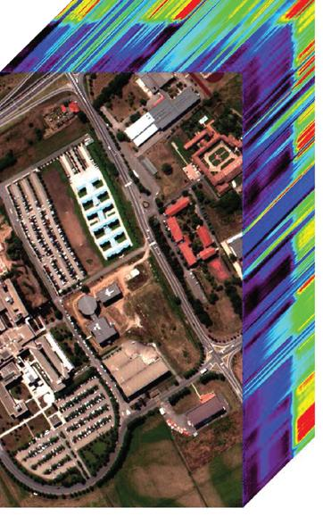





Hyper-spectral Image Classification
2

Slide 3






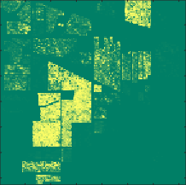
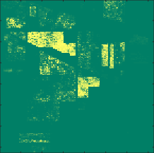







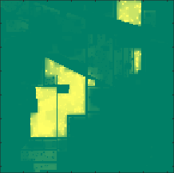
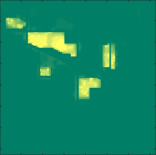

Our Smooth-and-Threshold (SaT) Approach
Traditional SVM Method

Slide 4
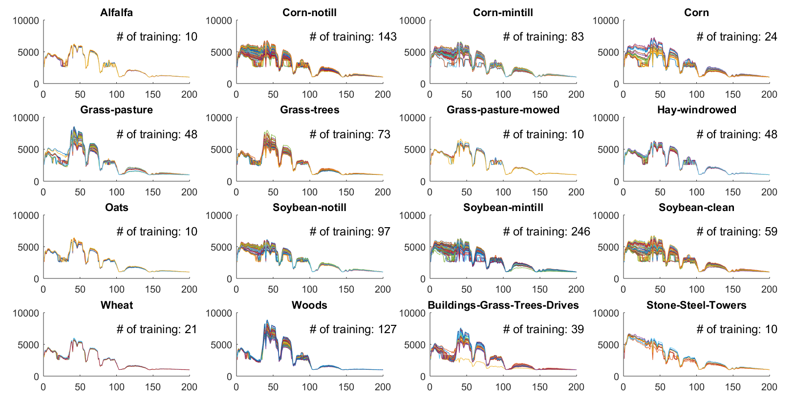
Indian Pines Data Set

Slide 5

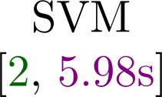
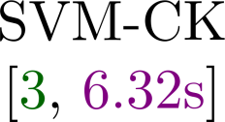
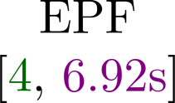

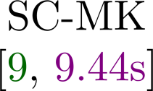
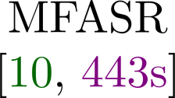
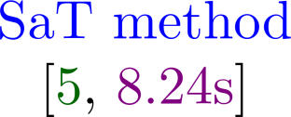

Indian Pines Data Set

Slide 6


Comparison with Other Methods

Slide 7

Effect of the High-order Smoothing Term

