Slide 1
MMAT 5390: Mathematical Imaging
Lecture 8:
Examples of High Pass Filtering
Prof. Ronald Lok Ming Lui Department of Mathematics,
The Chinese University of Hong Kong

Slide 2
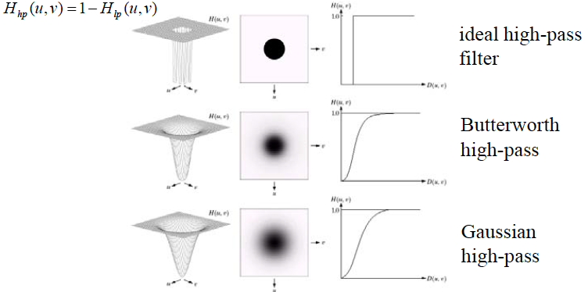
High Pass Filter

Slide 3
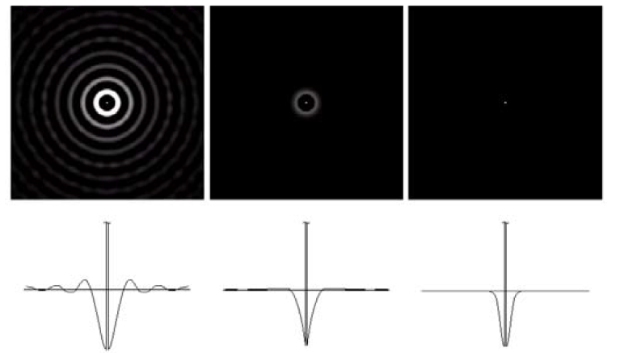
Spatial representation of High Pass Filter
Ideal
Butterworth
Gaussian
(Ringing effect is expected)

Slide 4
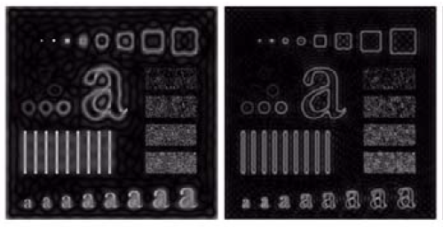
Ideal High Pass Filter
Butterworh
D0 = 15
D0 = 30
(Ringing effect is observed)

Slide 5
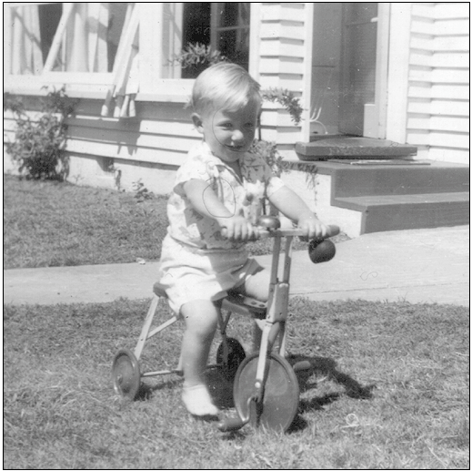
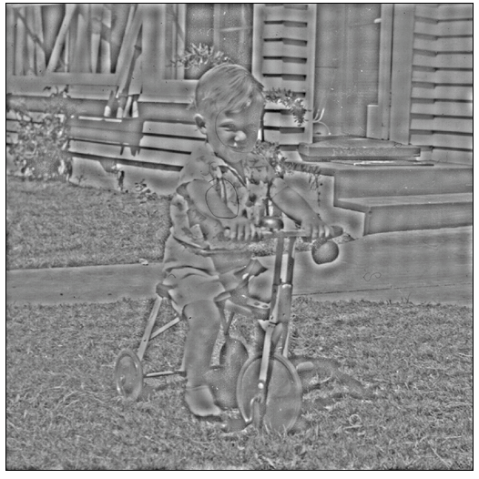
Ideal High Pass Filter

Slide 6
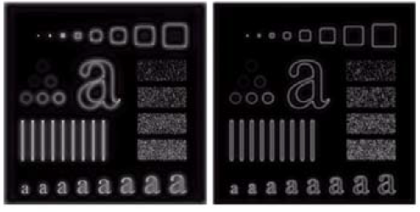
Butterworth High Pass Filter
D0 = 15
D0 = 30

Slide 7
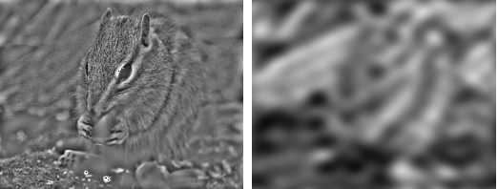
Comparison: High Pass Filter
High-pass filtering
Low-pass filtering

